Slide 1
Water: Priceless Resource?
Karst Institute
Guizhou University
June 20, 2011
by Merton Finkler, Ph.D
Lawrence University

Slide 2
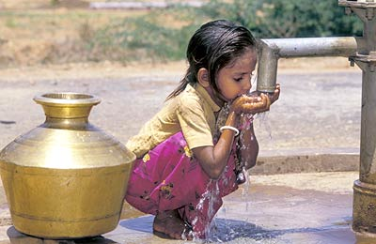
Priceless

Slide 3
Priceless
Definition 1: Item so valuable that it is impossible or immoral to put a high enough price on it
Definition 2: Item that can be used without paying anything – a price of zero.
Two definitions are polar opposites but both apply to how we manage our water.

Slide 4
Fresh Water is Scarce
97% of available water is sea or salt water.
Of the remaining 3%, << 1% is available for human consumption.
When available, economic development can be sustained; if not, people struggle to survive.
Moving water is costly - pumps and piping are required for delivery.
At least 30 countries have experienced shortages of fresh water.

Slide 5
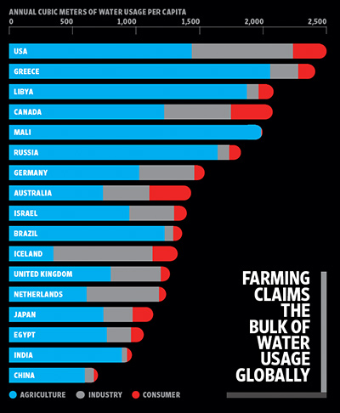

Slide 6
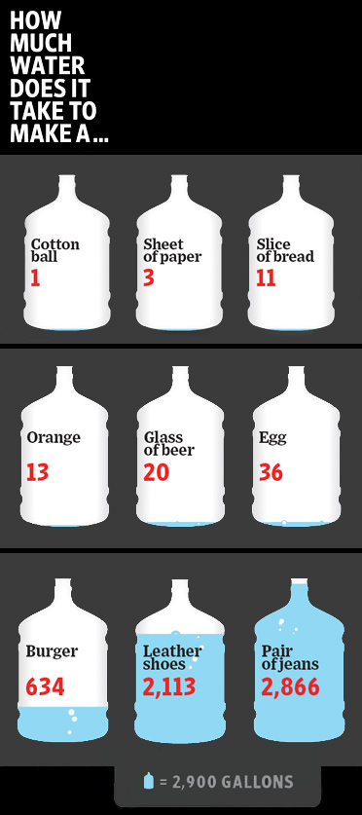

Slide 7
We Waste a Lot of Water
Pipe leakage – deteriorating infrastructure
Subsidized agriculture leads to crops that are water dependent
Water quality depends on adequate sanitation and filtering. Infrastructure gaps are common.
Poor quality water yields increased disease, reduced productivity & poor quality of life.
Existent problems, however, mean opportunities for both private and social entrepreneurs.

Slide 8
Water Rights Are Critical
Water flow knows no boundaries and ignores political borders thus measurement is difficult.
Surface water & ground water interact in many ways dependent upon land use development.
Thus, stewardship of our water resources is essential.
Effective stewardship requires clear rights determination, monitoring /measurement, and enforcement.

Slide 9
Water Rights Definition 1
Riparian water rights: water belongs to the landowner next to the source if he/she makes “reasonable” use of it
Irrigation
Domestic household purposes
Navigation
Can erect docks, piers, and boat lifts
Swimming, boating, and fishing
Cannot transfer water rights without land transfer
Common in Eastern half of the US

Slide 10
Water Right Definition 2
Prior Appropriation: “Colorado Doctrine”
Unconnected to land ownership
“First in time, most senior right” – with quantity set by date of use
“Use it or lose it” often applies with beneficial use typically defined as agricultural, industrial or household
Abandonment of right is rare: if transferable, rights will be sold.
Governments can set reserved use – for example, navigable waters cannot be restricted.
Common in Western US

Slide 11
Water Right Definition 3
Public Trust Doctrine: All navigable waters are “common highways and forever free.”
Wisconsin – “All Wisconsin citizens have the right to boat, fish, hunt, ice skate, and swim on navigable waters, as well as enjoy the natural beauty of navigable waters, and enjoy the quality and quantity of water that supports those uses.”
Wisconsin: Public’s rights are primary; riparian owner’s are secondary.

Slide 12
Wisconsin Water Rights (Cont.)
Riparian rights limited by “reasonable” use and the PTD
WI Dept of Natural Resources determines reasonable use and applies PTD
Fundamental ? As technology changes, and historically “reasonable” use exceeds supply, how should water be allocated ?
Political strength of traditional uses is difficult to change

Slide 13
All Definitions Generate Conflict
Traditional users versus homesteaders
Agricultural versus urban uses
Commercial vs. amenity demands
Ecological preferences conflict with other preferences (including waste disposal/runoff)
Those inside the watershed basin and those outside – a central issue addressed by the Great Lakes Compact

Slide 14
Water Rights Definition 4
Oregon water law is based on prior appropriation
Instream Water Rights Act (1987) and Conserved Water Program allow water to be traded with 75% reallocated by rights holder and 25% to the state
Rights can be traded
Oregon Water Trust provides both expertise and networking opportunities

Slide 15
Non-Scarcity Pricing Yields Waste
Urban prices > Agricultural prices & restricted exchange leads to crops that heavily use water.
No easy way to have those interested in the ecological or amenity value bid for water
Dumping waste into water is too cheap – often no cost until target level then shutdown.

Slide 16
Non-Scarcity Prices (Cont.)
Pricing based solely on piping and pumping costs yields low prices for high use.
Ill-defined property rights or public ownership  too little stewardship and too much politics.

Slide 17
Ownership and Pricing
Tradeable ownership rights allow people to sell water to those who desire them more
No need to “use it or lose it”
Can trade across seasons
Can conserve water and trade rights
These things all happen in Oregon with the assistance of the Oregon Water Trust

Slide 18
Water Rates – Policy Considerations
Rate Design
Water
Conservation
Equitability
Affordability
Revenue Stability
Easy to
Implement
Public Understanding
Adequate Revenue

Slide 19
Water Rate Designs
Notes:
There are essentially an infinite number of options for designing rates. Different rate structures have different advantages and disadvantages, and some structures may work better for a particular utility.
Declining block rates have been used historically in Wisconsin for simplicity and to allow for a single rate design for all customer classes. Another common rate design is uniform rates, which are easy to implement.
Recently, there has been considerable interest in using what has been called “conservation” rate structures such as inclining blocks and seasonal rates. Proponents argue that conservation-oriented rates can:
help a utility manage its supply more efficiently,
encourage consumers to make wise choices, and
have positive environmental effects – mainly, saving water!
While conservation rate structures can in fact help to achieve these purposes, it is important to keep in mind that the overall price of water may also play a bigger role in water conservation. Thus, the size of the blocks and the price differential are as important, and in some cases, more important than the actual rate structure.
Bottom Line: Under any design, rates should be supported by the cost of service study. This provides the public reassurance that the monopoly service is appropriately priced.

Slide 20
Water Rates as a Conservation Tool
Appropriate price signals encourage efficient water use
Rates must be reasonable (Ch. 196, Wis. Stats.)
Rates should match community goals
Reduce annual average use
Limit peak demand
Achieve long-term or seasonal savings
Target one or more customer classes
Notes:
Approximately 20 percent of the utilities responding to the survey said they were “likely or highly likely” to seek water conservation rates.
The rates that utilities charge their customers can send a price signals that communicates the value of water to utility customers. As a result, rates can be an effective component of a water conservation program.
The PSC is encouraging utilities to consider implementing conservation rates as part of a comprehensive conservation strategy where they are appropriate. Regardless of the rate structure used, Wisconsin law requires that the rates charged be reasonable.
In determining whether water conservation rates are appropriate, the utility should first identify its water conservation goals, which will help PSC staff in designing reasonable rates to meet these goals. For example, the rate structure may be different depending on whether the utility is seeking to:
Reduce annual usage
Limit peak water demand.
Achieve long term vs. short term savings
Target one or more customer classes

Slide 21
Water Rates – Design Comparison
Rate Structure | Advantages | Disadvantages
Uniform Rates | Easy to understand Revenue stability | Difficulty matching COSS Little conservation incentive
Declining Block | Common in WI One rate structure for all classes Revenue stability | No conservation incentive Infrequent use elsewhere
Inclining Block | Easy to understand More conservation incentive | More difficult to administer Less revenue stability Inequitable for some classes
Seasonal | Those creating peaks pay Relatively simple to administer | Revenues susceptible to weather Inequitable for some classes
Goal-Based (Budget) | More equitable? Fund conservation programs | Complex Additional billing costs Requires customer education
Notes:
[Skip this slide]

Slide 22
Conservation Rate Designs
Notes:
Notes about Waukesha:
The PSC approved Waukesha’s inclining block rate in May of 2007.
First block was large because of concerns about single-metered duplexes.
It is difficult to separate out rates from other factors – such as weather and the effects of other measures (education, outreach, lawn watering ban, etc.)
Maximum day demand dropped 26 percent from 12.9 mgd to 9.6 mgd.
In 2007, there were no days that exceeded 10 mgd, while in 2005 there were 28 days.
The number of customers billed at the top block – 40,000 gallons in above, declined 40 percent, from 2,928 in 2005 to 1,750 in 2007.
Total sales in the top block declined 40 percent from 168 million gallons to 101 million gallons.
Next Steps Here:
Create multifamily customer class and rates.
Fine tune rate blocks for single family residential customers.

Slide 23
Conservation Rate Designs
* Allouez bills monthly; rate blocks are normalized to equivalent three month volumes.
Notes:
Notes about Allouez:
Rates were approved in October 2008.
Water is very expensive in Allouez. The average cost for a residential customer (18,750 gallons) is about $120 per quarter, which is higher than the statewide average of $71.
No industrial customers - mostly residential/small commercial. Allouez was concerned about peak capacity and summertime lawn watering, given the fixed allocation available through the Central Brown County Water Authority.
PSC required Allouez to report on effectiveness after one year.
Next Steps:
Address high water use at public authority customers (prisons) through non-rate mechanisms.
Monitor the effectiveness of the rate structure.

Slide 24
Chongqing Water Tariffs
Development and Reform Commission instituted in 2001
4 Principles
Seek to benefit both users and providers
Price based on consumption but help the disadvantaged
Introduce rate and subsidy changes slowly
Reveal the scarcity of water and thus help promote healthy and rational behavior.

Slide 25
Chongqing Results
People recognize that low tariffs are costly over time.
Acceptance of benefit principle: user pays
Applied to water resource use, water supply and sewerage
Percentage of wastewater treating has gone from 5% (2000) to 80% (today.)
Water consumption reduced by 3 to 5% soon after tariff increase.

Slide 26
China Water Rates – RMB/m³

Slide 27
Thank you for your attention
I welcome your questions

Slide 28
Water Rights Are Hard to Define
Fresh water is a common property resource which means users are rivals, but they are hard to exclude  wasteful use is commonplace.
Measurement can be based on either existent measures of stock of water or annual flows
Divergence and dumping affect the available supply of fresh water
Desired quality of water differs markedly across uses but complex governance and pricing are needed to deliver appropriate quality levels.

Slide 29
Quarterly Bills for 18,750 Gallons (2008)
Notes:
Background on Wisconsin Water Rates
However, water remains relatively cheap in Wisconsin. And studies have shown that demand can be somewhat inelastic, implementing conservation rates alone may not be sufficient to influence customer behavior and to reduce demand. Other measures, such as public education and outreach, must be considered as part of a comprehensive water conservation program.
The PSC compares the rates across utilities each year using a benchmark of 18,750 per quarter. While this number may be a bit higher than actual average uses, it provides for a historical comparison. In 2008, the average cost of 18,750 gallons was $71.79 per quarter, or about $288 per year. For comparison, some have estimated that Americans spend more than $800 each year on soft drinks.
As shown in this graph, most residential customers pay between $30 to $80 per quarter for water, with some being higher and some being lower. Variation in price can be attributed to many factors:
Customer diversity
Age of system
Construction projects
Number of customers
Quality of source water
Availability of alternate sources

Slide 30
Who Gets the Water?
Political influence decides – money often buys influence; short term demands tend to dictate use.
Public trust determines “broad” interest – efficient use depends upon independence from “narrow” interests.
Independent trusts that act as stewards may be able to resist political meddling – Nature Conservancy and the Oregon Water Trust
The Ideal: well defined and tradable property rights that give incentives to rights holders to act as stewards and use water for highest value

Slide 31
Current Wisconsin Practice
Started using water rates for conservation
Features very different rates for different classes of user with agricultural and industrial rates much below residential
This yields both inefficient (wasteful) and inequitable results.
If water conservation is to become a serious policy objective, stronger pricing incentives are needed.

